Slide 1
Grid Search Fitting Methods
Nathan Snyder
July 2, 2021

Slide 2
Process
Local Fit
Result Cleaner
Local Fit
Result Narrower
Local Fit
Global Fit

Slide 3
Grid Search Local Fit Algorithm
Start with the guesses for the CFFs being all 0.
Two hyperparameters:
num = the number of points tested on either side of the guess (how ‘dense’ the grid is)
totalDist = the total distance being tested on either side of the guess (how wide the grid is)
Generate a grid of the CFFs where each CFF value is in the range [guess - totalDist, guess + totalDist]
There are (2*num + 1)^3 points in this grid. When num=10, there are 9261 points.
Whichever point in the grid produces the least error in F becomes the new guesses for the CFFs.
Repeat until the guesses stop changing.
When the guesses stabilize, decrease the size of the grid and run again.
totalDist /= num
In the end, this algorithm will produce the CFF values that have the lowest error in F.

Slide 4
Grid Search Local Fit Algorithm
Replicas
A random number in the range [0, 1] is generated (from a uniform distribution)
Converted to a Gaussian distribution (mean=0, stddev=1) using the Box-Muller transformation
This value represents the number of standard deviations that a particular index’s F value will be off by
Each replica is an array of these values – one for each index
The algorithm described on the previous slide is run for 100 replicas
From there, it takes the mean and standard deviation of the CFF values that were produced

Slide 5
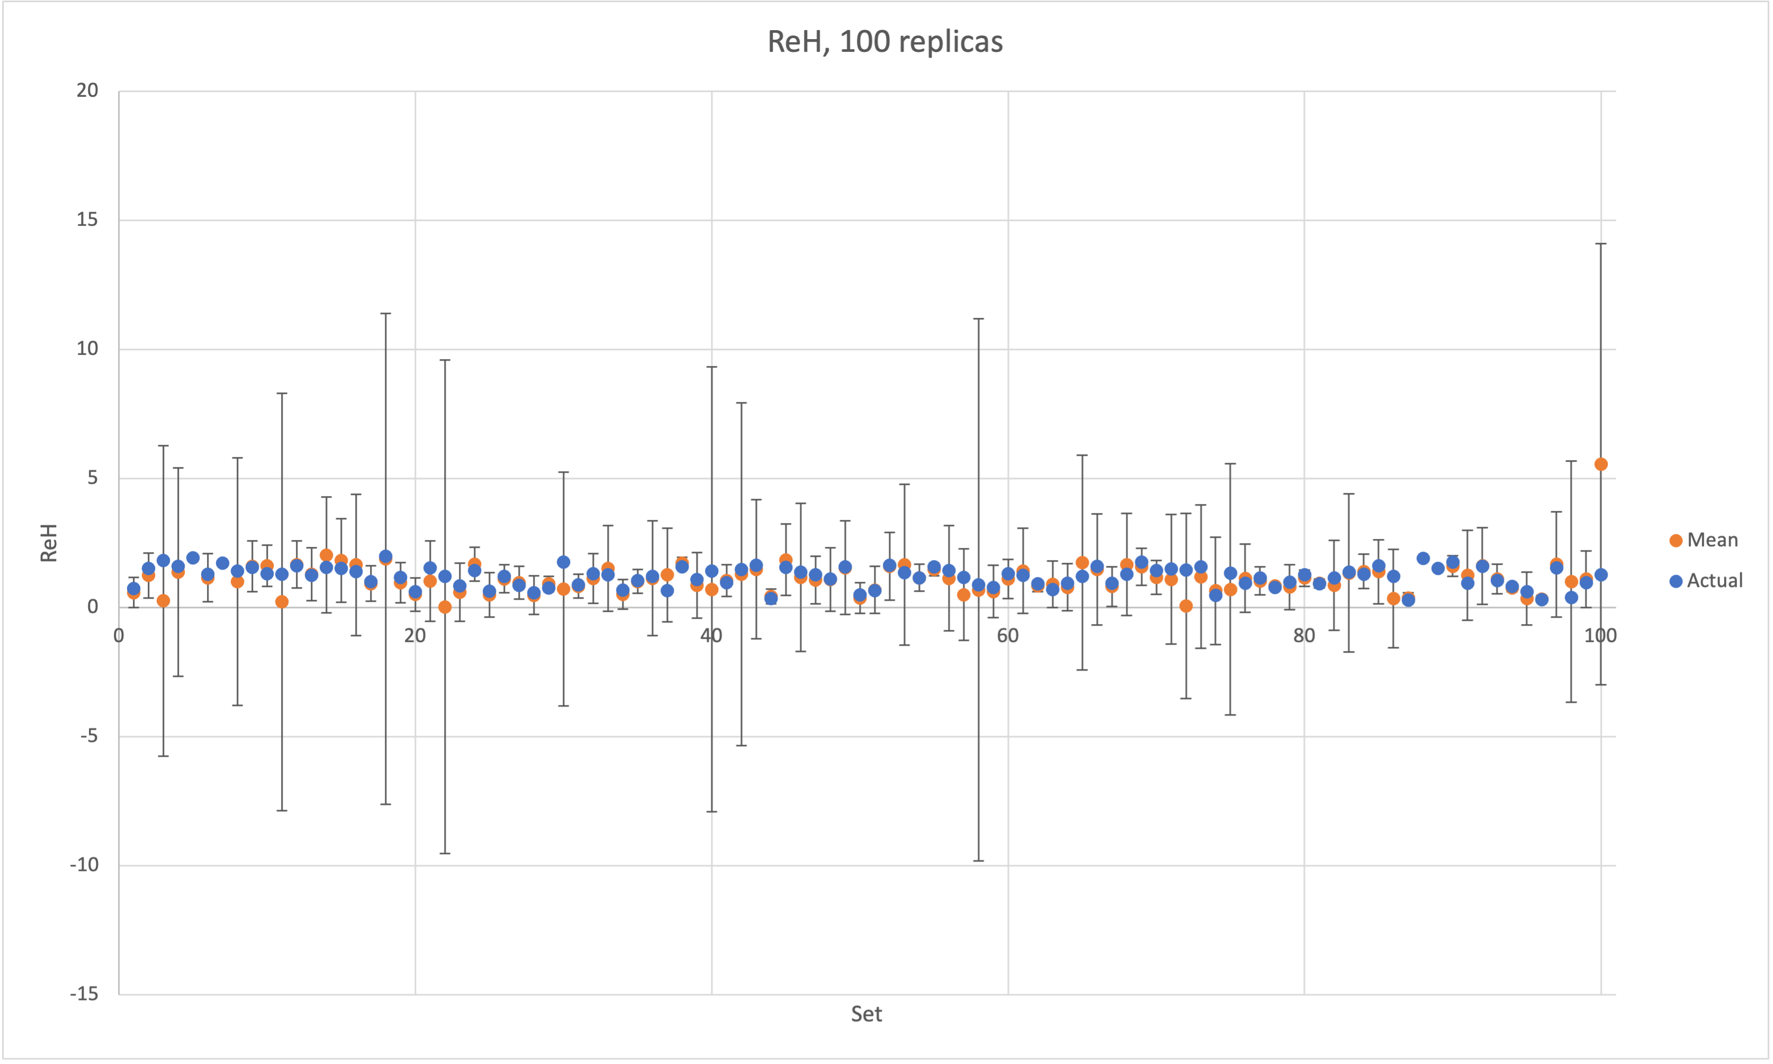
Grid Search Local Fit Results

Slide 6
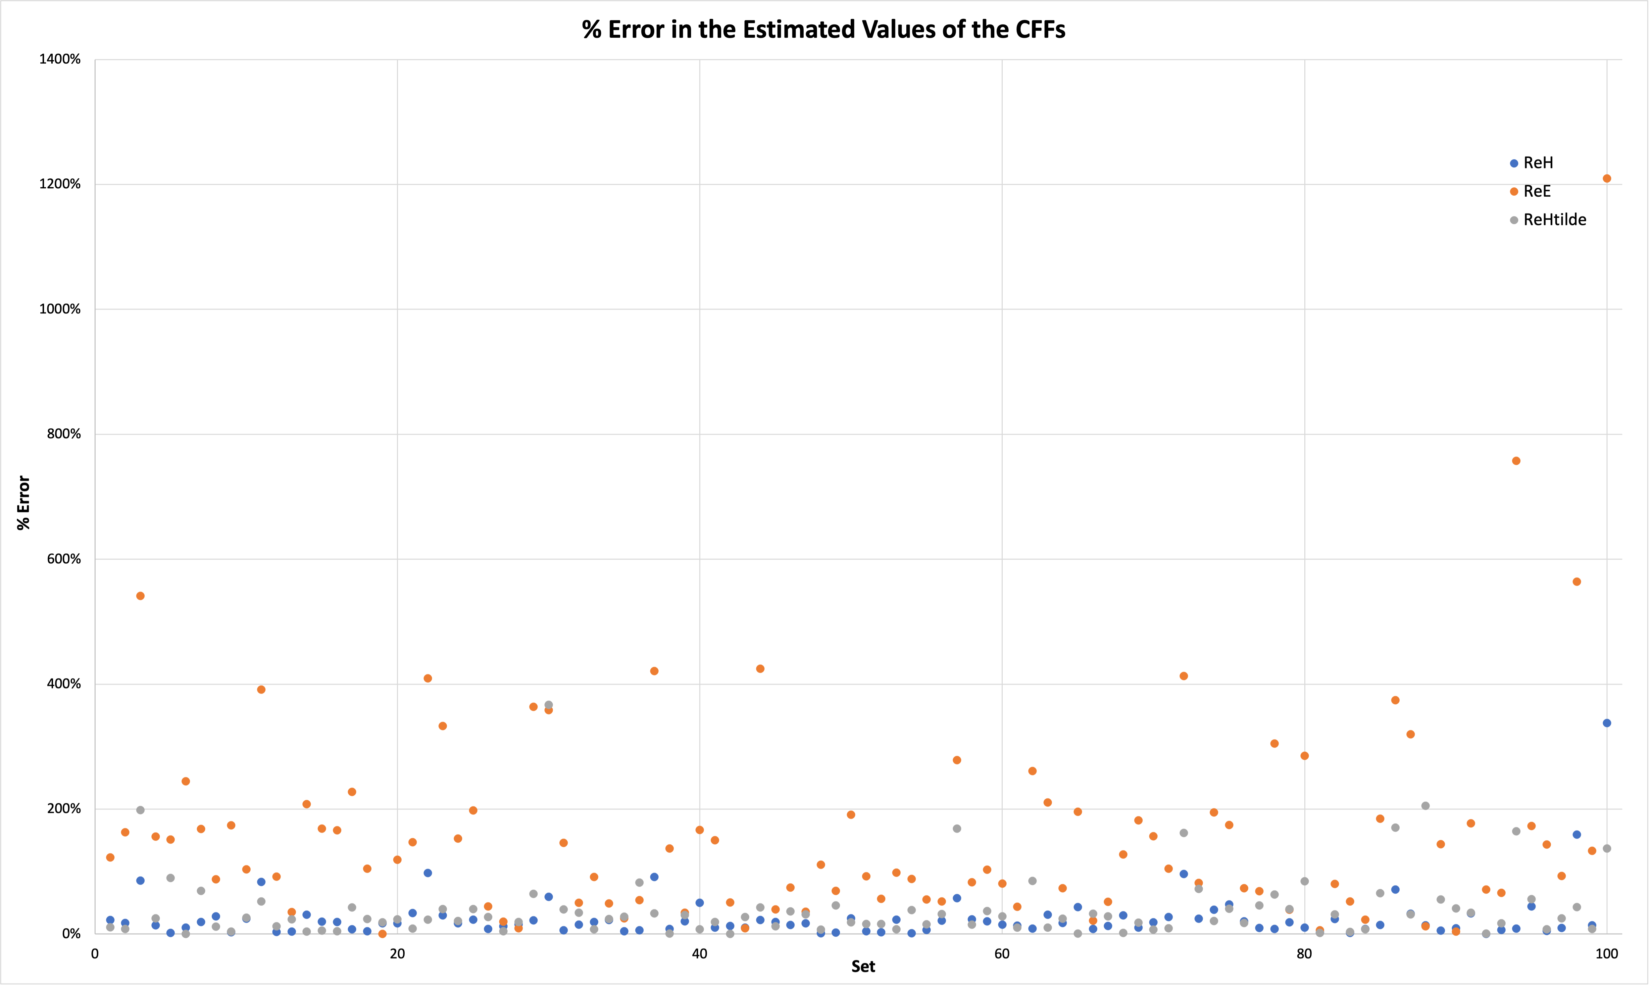
Grid Search Local Fit Results

Slide 7
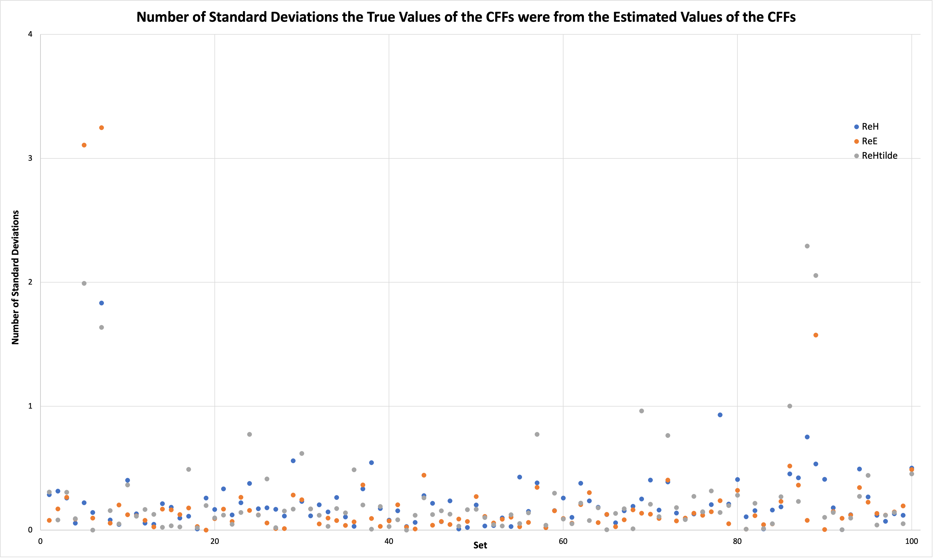
Grid Search Local Fit Results

Slide 8
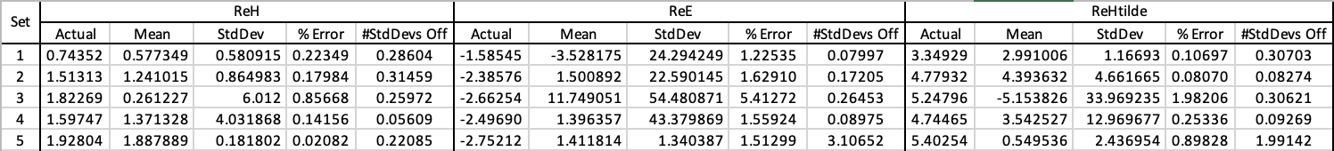
Grid Search Local Fit Results
The ReE values are generally less accurate but have larger error.
All sets that have a CFF that is off by more than 1 standard deviation have a very low ReE standard deviation

Slide 9
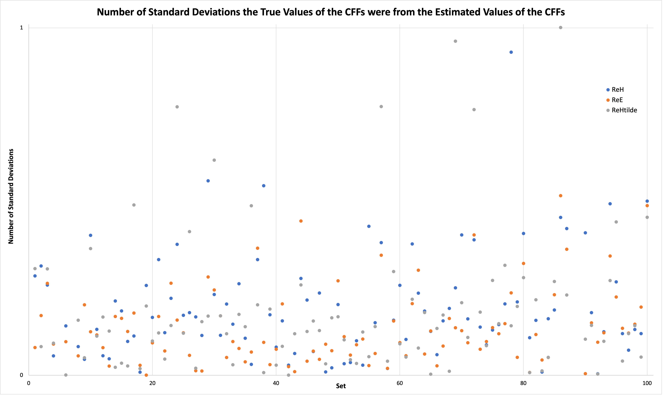
Local Fit Result Cleaner
Removes all sets with an ReE standard deviation that is smaller than one standard deviation less than the mean

Slide 10
Local Fit Result Narrower
At this point, we can assume that the grid search local fit + result cleaner can produce results that always contain the true values in their error bars.
The next step is to decrease the error bars so we can have a tighter fit.

Slide 11
Grid Search Global Fit Algorithm
The global fit uses almost the same algorithm as the grid search local fit
Instead of fitting values of ReH, ReE, and ReHtilde, it fits values of coefficients in this equation:
$CFF=c_{0}k+ c_{1}k^{2}+$ $c_{2}QQ+ c_{3}{QQ}^{2}+ c_{4}x_{b}+ c_{5}{x_{b}}^{2}+ c_{6}t+ c_{7}t^{2}+c_{8}$
The exact same approach as in the grid search local fit is not feasible because we are fitting 9 variables
Total number of points tested in the local fit: 21^3 = 9,261
If we did the same algorithm in the global fit: 21^9 = 794,280,046,581
Rethink grid as concentric spheres and randomly generate points that are a specified radius away from the guess
This method still requires checking millions of points to get good coverage of the space

Slide 12
Grid Search Global Fit Results
When run on the true CFF values:
<0.1% error in all CFFs
When run on the grid search local fit results and just considering the mean values and not their errors:
More than 50% error in ReH and ReHtilde
More than 90% error in ReE
We know that the true values are within the error bars of the grid search local fit results but we don’t know where.
Possible methods for finding the true values:
Randomly guess the true value for each set within the local fit’s error bars and repeat until the error in the global fit results is ~0%.
Clearly not feasible.
Shift the guessed value for each set one-by-one to the place where the error in the global fit’s results is lowest
Decreases the error in the global fit results for ReH from 50% to 15%.
Does not shift values in the correct direction.
The final equation does not match the correct equation.
Use replicas in the same way as the local fit?

